Slide 1

Phase 3 Project
Ryan S. Chung

Slide 2

Outline
Business Problem
Data and Methods
Conclusions

Slide 3
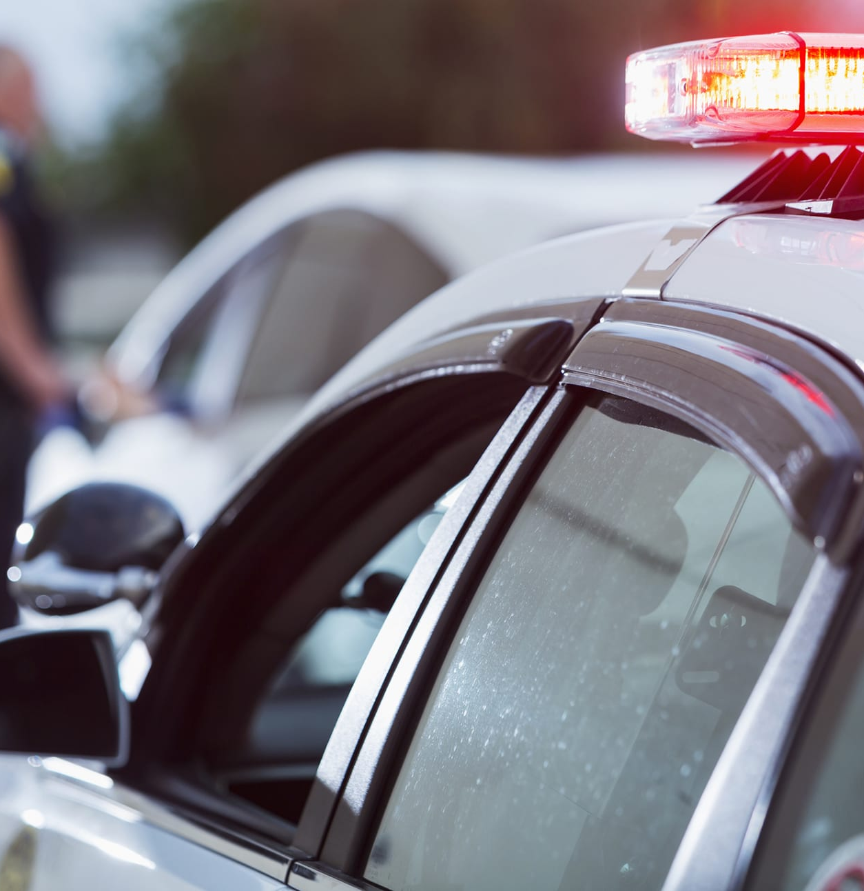
Business Problem
For this project, a data set containing information on stops made based on suspicious behavior was provided and our goal was to create models that could accurately predict whether an arrest was made or not given the rest of the information provided on each stop made.

Slide 4
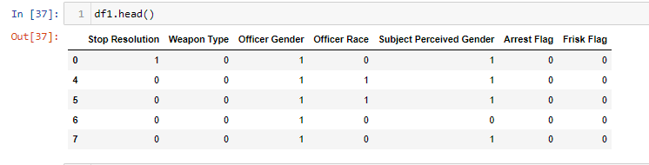
Data Used
The data set used was obtained from data.gov called Terry Stops. It contains records of police reported under the supreme court case Terry v. Ohio 1967. Each data point contains various aspects of each stop made such as time reported, officer gender, stop resolution, perceived subject race, etc.
The cleaned data set used for the creation of each model is comprised of each feature being assigned a value of 0 or 1. (Reference code for context of what 0 or 1 indicates).

Slide 5
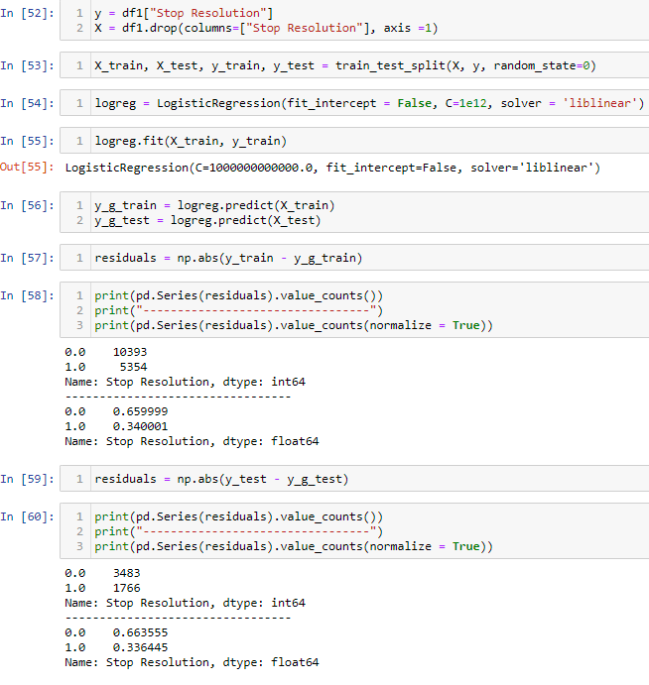
First Model
A Logistic Regression Model was then created and the model had an accuracy of 65.9% on the training set with an accuracy of 66.4% on the test set.

Slide 6
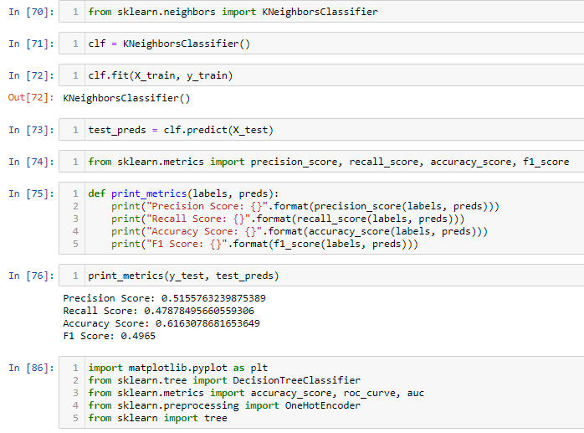
Second Model
The second model created was a K Neighbors Classifier Model. This model was found to have an accuracy score of 61.6% with an F1 Score of 0.4965.

Slide 7
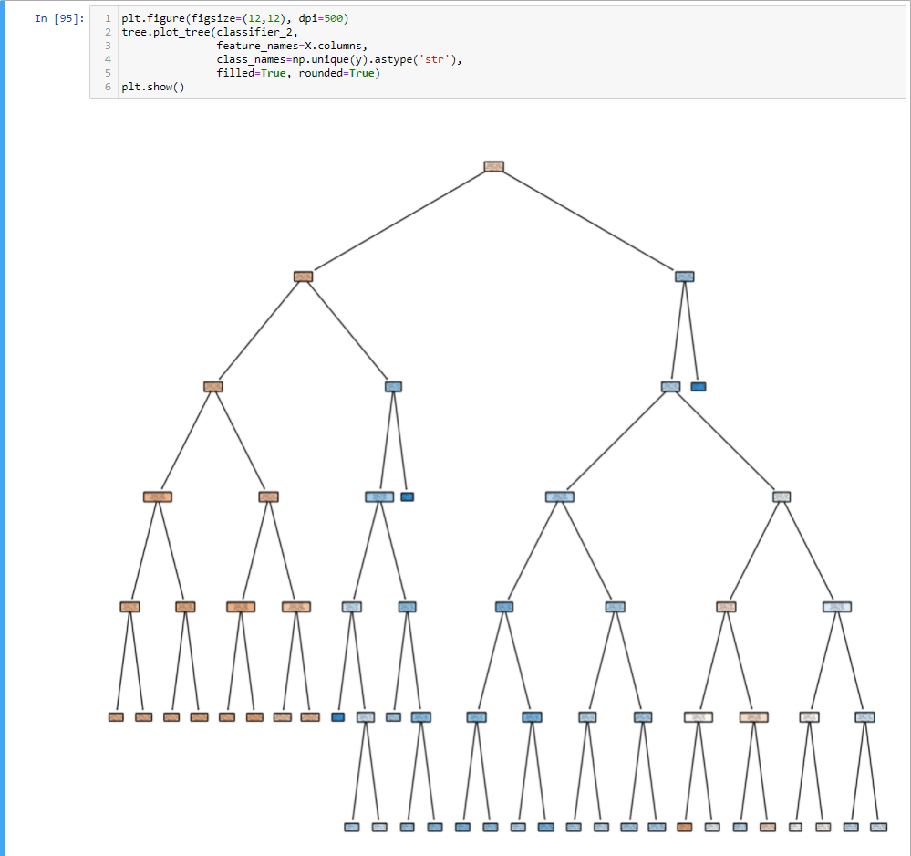
Third Model
The third model created was a Decision Tree Classifier Model which was found to have an accuracy score of 66.1%. The AUC was 0.61.

Slide 8
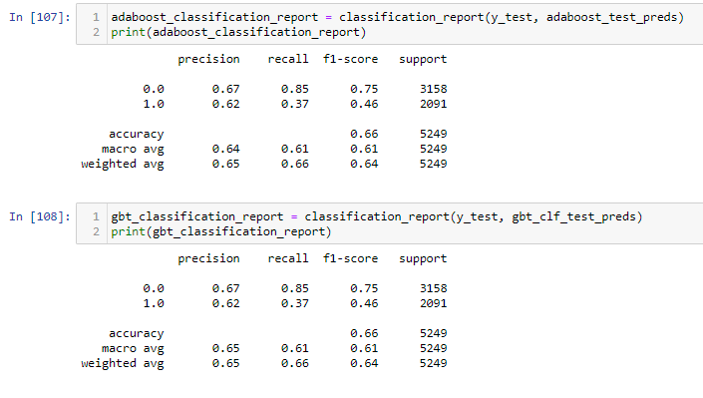
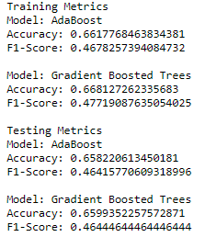
Final Models
The final models created were an Adaboost and Gradient Boosting Classifier.
The accuracy and F1 scores of both models on the training and testing metrics can be seen below.

Slide 9
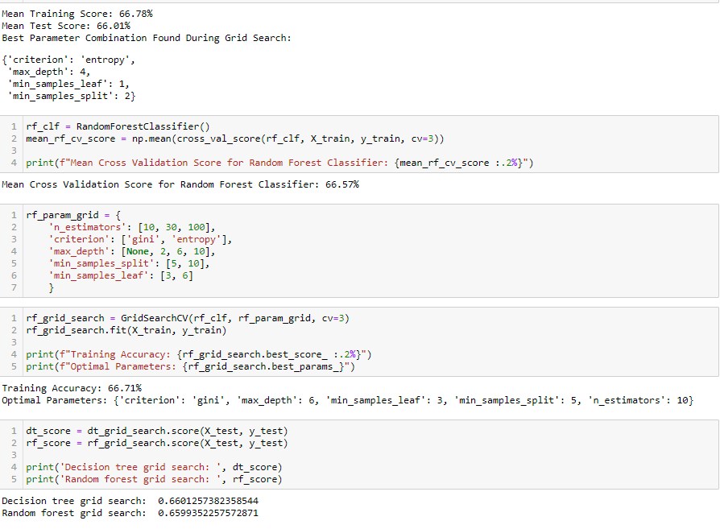
Grid Search
After reviewing all models and their accuracy ratings. The decision tree classifier model was chosen to be run through grid search. The mean cross validation score was 66.55% and the grid search was made to run through 648 different permutations. It was found that the random forest grid search slightly underperformed compared to the baseline model.

Slide 10
Conclusions
Looking back at our initial models we can see most of them were able to have an accuracy of around 60% on predicting whether an arrest or not was made based off of the data from the cleaned set. It is important to keep in mind that the aspects of each arrest used in these models included weapon type, officer gender, officer race, subject perceived gender, arrest flag, and frisk flag. Keeping in mind how each feature was categorized to be used in each model would be necessary in understanding what the models actually look at. When running the decision tree classifier through grid search it seems it could be further tuned for better accuracy.

Slide 11

Thank you

